Slide 1



Knee Osteoarthritis
Prediction and Progression using Multi-Modal Deep Learning.
Group ID - 25-26J-112
01

Slide 2




Our Team
25 – 26J - 112
Supervisor - Ms. Jenny Krishara
Co-Supervisor - Ms. Wishalya Tissera
IT22223708
Fernando W.D.A
IT22582942
Jayasinghe J.M.N.S.
IT22606792
Perera B.B.A.R
IT22188472
Gamage D.M.G.P.K
02

Slide 3
INTRODUCTION TO PROBLEM
01
02
What is Knee Osteoarthritis?
How is it Currently Diagnosed and monitored?
  A chronic joint disease where the protective knee cartilage breaks down.
  Causes pain, stiffness, swelling, and reduced mobility.
A leading cause of disability, affecting millions worldwide
  Clinical Exams
  Medical Imaging
  Patient History
25 – 26J - 112
03

Slide 4
  Impact/Gravity
  The current KOA diagnosis and management process suffers from several critical limitations.
  Heavy reliance on manual interpretation of X-ray and MRI images
  Lack of early stage detection and severity prediction
  Minimal use of integrated clinical, demographic, and imaging data
  Absence of intelligent treatment recommendation or decision-support tools
  KOA is often diagnosed at advanced stages
  Patients experience long-term pain, reduced mobility, and loss of productivity
  Healthcare systems face increased costs due to delayed interventions
  Clinicians face high workload and diagnostic inconsistency
As a
result
04

Slide 5
  Stakeholders Impact
01
Patients
    Faster and earlier detection of knee osteoarthritis
    Reduced diagnostic delays and uncertainty
02
Healthcare Professionals
      Decision-support for orthopedic surgeons and radiologists
      Reduced manual workload in image interpretation
      Consistent and objective diagnostic assistance
      Support for early-stage and borderline case identification
03
Healthcare Institutions
Improved diagnostic efficiency and workflow automation
      Reduced operational costs and reporting time
      Scalable AI-assisted screening solution
      Enhanced service quality in hospitals and diagnostic centers
04
Society & Technology
      Strengthened public healthcare systems through early intervention
      Increased accessibility to AI-based medical diagnostics
      Support for digital health and clinical decision-support platforms
      Advancement of AI adoption in healthcare, especially in developing regions
05

Slide 6
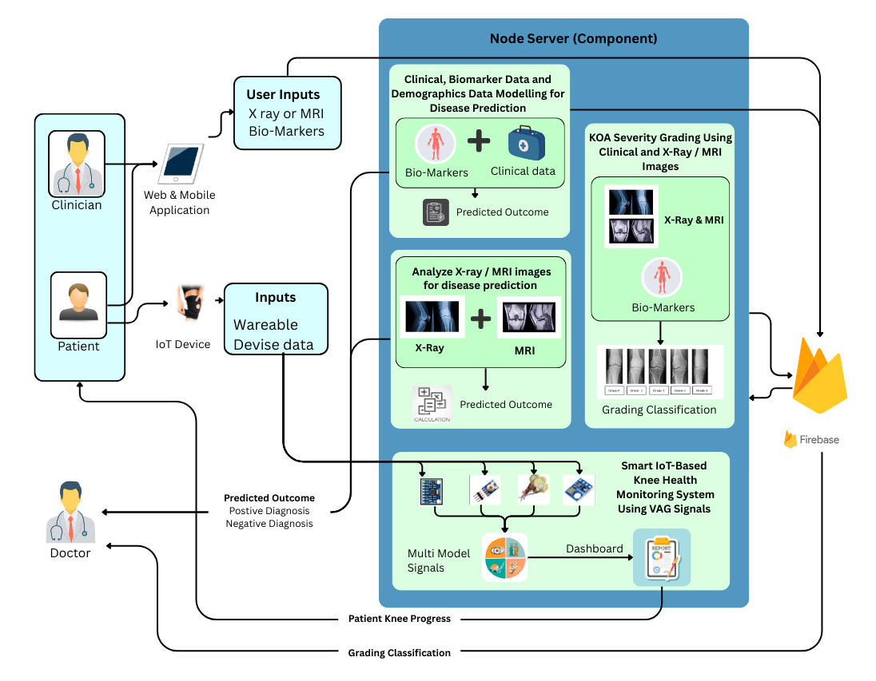
Overall solution as a system diagram
25 – 26J - 112
06

Slide 7

IT22582942 | Jayasinghe J.M.N.S
Demographic, Clinical and Biomarker
Data for KOA Prediction
Specialization : Data Science
25 – 26J - 112
07

Slide 8
~ Demographic, Clinical and Biomarker ​Data for KOA Prediction​ ~
  How the Solution Addresses the Sub-Problem
  It is challenging for doctors to diagnose KOA in its initial phase
  Current research often focuses on one data type
  Designed solution predicts KOA using demographic, clinical and biomarker data
  Enables early risk detection before severe disease progression
  User Requirements Addressed by the solution
Early identification of KOA risk for patients
Non-invasive assessment using routine medical data
Simple and fast screening mechanism
Data-driven decision support for clinicians
Scalable solution suitable for hospitals and clinics
Reliable prediction results with realistic performance
IT22582942 | Jayasinghe J.M.N.S | 25-26J-112
08

Slide 9
~ Demographic, Clinical and Biomarker ​Data for KOA Prediction​ ~
Design Excellence/ Contribution
Integration of multiple data types (demographic, clinical, biomarkers)
Data preprocessing
  Handling missing values
  Removing duplicates
  Encoding categorical variables
  Handling class Imbalance
Evaluation of multiple ML models
  Random Forest
  XGBoost
  Gradient Boosting
IT22582942 | Jayasinghe J.M.N.S | 25-26J-112
09

Slide 10
~ Demographic, Clinical and Biomarker ​Data for KOA Prediction​ ~
Trained Models
Model | Training Accuracy | Testing Accuracy | Validation Accuracy
Random Forest | 88.93% | 87.38% | 87.28%
XGBoost | 85.63% | 87.50% | 89.87%
Gradient Boosting | 83.28% | 85.50% | 88.12%
Logistic Regression | 82.18% | 85.00% | 86.25%
IT22582942 | Jayasinghe J.M.N.S | 25-26J-112
10

Slide 11
~ Demographic, Clinical and Biomarker ​Data for KOA Prediction​ ~
USER FEEDBACK ON PROTOTYPE
Useful as a preliminary KOA screening tool
Helps clinicians identify high-risk patients early
Easy to use with minimal data input
Reduces unnecessary imaging for low-risk patients
FUTURE WORK
Improve model accuracy
Enhance mobile application features and usability.
IT22582942 | Jayasinghe J.M.N.S | 25-26J-112
11

Slide 12

IT22223708 | Fernando W.D.A
Analyze X-ray / MRI images for
disease prediction
Specialization : Data Science
25 – 26J - 112
13

Slide 13
~ Analyze X-ray or MRI images for disease prediction ~
How the Solution Addresses the Sub-Problem
Automates the analysis of knee X-ray (and extendable to MRI) images for osteoarthritis detection
Uses deep learning–based image classification models to learn disease-specific visual patterns
Classifies medical images into Normal vs. Osteoarthritis categories
Reduces manual interpretation time and subjectivity in diagnosis
Prototype demonstrates validated prediction performance using real medical image datasets
User Requirements Addressed by the solution
Healthcare Professionals
AI-assisted decision support for image interpretation
Reduced manual workload and diagnostic subjectivity
Consistent and repeatable diagnostic results
IT22223708 | Fernando W.D.A | 25-26J-112
14

Slide 14
~ Analyze X-ray or MRI images for disease prediction ~
Design Excellence/ Contribution
Data Preparation
Applied stratified 70/15/15 re-splitting to ensure fair class distribution
Prevented data leakage between training, validation, and testing sets
Advanced Image Preprocessing
Enhanced knee joint visibility using CLAHE.
Improved feature clarity in low-contrast medical X-ray images.
Applied consistent preprocessing across all experiments for fair comparison.
Multi-Model Deep Learning Evaluation
Designed and trained multiple CNN architectures
Enabled objective comparison to identify the most suitable architecture for KOA detection
Two-Stage Transfer Learning Strategy
Stage 1: Feature extraction using frozen pre-trained backbones
Stage 2: Fine-tuning higher-level layers for medical domain adaptation
Reduced overfitting while improving generalization on unseen data
Comprehensive Model Evalutions
Evaluated models using:
  -Accuracy
  -Confusion Matrix
  -ROC–AUC
IT22223708 | Fernando W.D.A | 25-26J-112
15

Slide 15
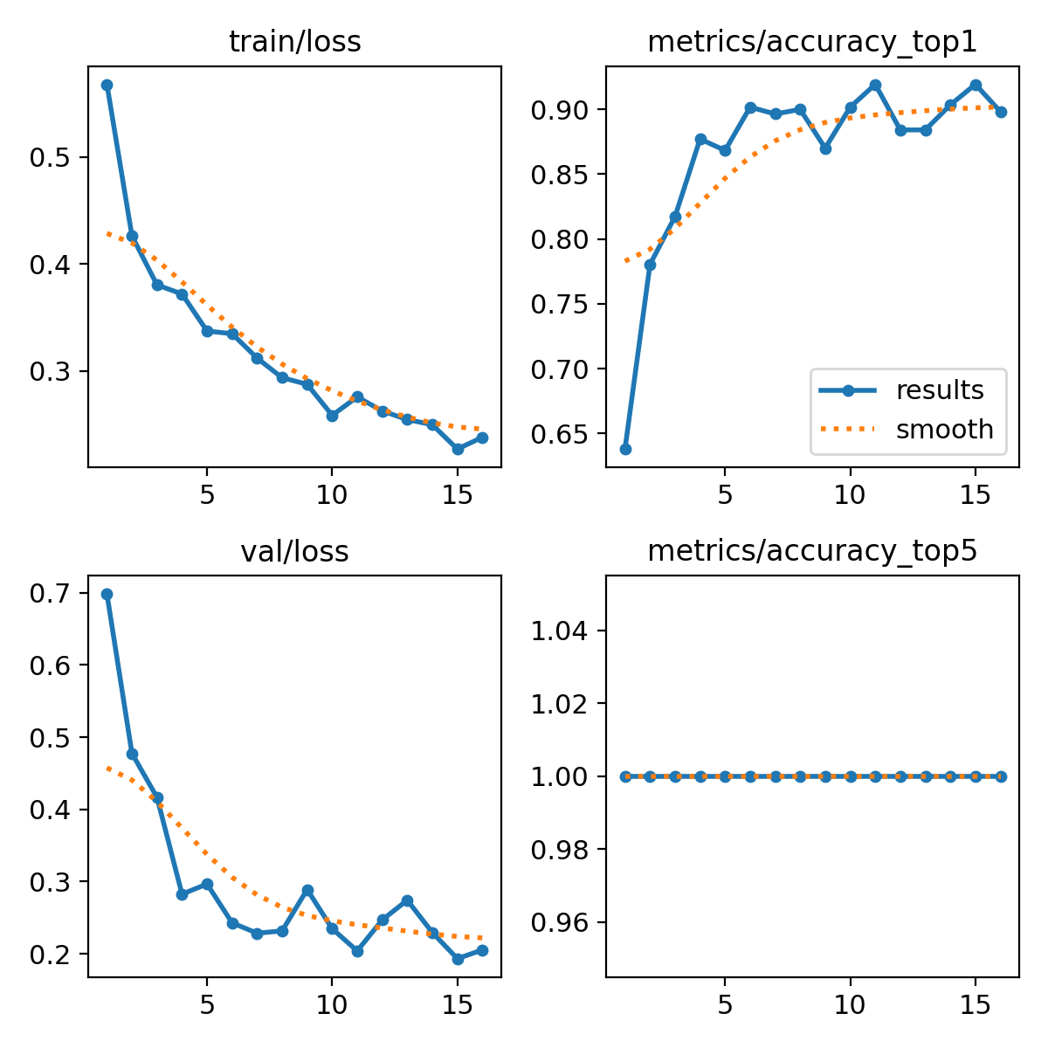
~ Analyze X-ray or MRI images for disease prediction ~
Trained Models
Model | Training Accuracy | Validation Accuracy | Testing Accuracy
DenseNet201 | 88.26% | 90.86% | 87.48%
EfficientNetB3 | 91.30% | 99.06% | 55.98%
Resnet50 | 88.22% | 89.10% | 86.77%
AlexNet | 74.15% | 80.67% | 79.72%
LeNet-5 | 49.86% | 49.38% | 52.20%
GoogLeNet | 89.62% | 87.87% | 88.01%
MobileNetV3 | 88.85% | 85.06% | 84.30%
YOLOv8 | - | 91.04% | 90.83%
YOLOv11 | - | 91.39% | 91.01%
IT22223708 | Fernando W.D.A | 25-26J-112
16

Slide 16
~ Analyze X-ray or MRI images for disease prediction ~
User Feedback On Prototype
AI predictions are clear, consistent, and easy to interpret
Model outputs help support clinical decision-making
Reduced dependency on manual image inspection
Positive feedback on early-stage disease detection capability
Suitable as a decision-support tool
  Future Work
Improve ML model performance.
Integrate MRI image analysis for improved KOA detection.
Combine imaging results with clinical & biomarker data.
Implement Explainable AI (Grad-CAM) for transparency.
Optimize models for real-time clinical deployment.
IT22223708 | Fernando W.D.A | 25-26J-112
17

Slide 17

IT22606792 | Perera B.B.A.R.
KOA Severity Grading Using
Clinical/Bio Marker data and X-ray Images
Specialization : Data Science
25 – 26J - 112
19

Slide 18
~ KOA Severity Grading ​Using Clinical and X-ray Images ~​​​​
How the Solution Addresses the Sub-Problem
    Automated KOA severity prediction using:
        Deep learning on X-ray images
        Machine learning on clinical & biomarker data
Reduces subjectivity and time-consuming manual KOA severity grading
Enables severity-aware treatment recommendations to support clinical decisions.
User Requirements Addressed by the solution
Orthopedic Doctors / Clinicians
  Fast and consistent KOA severity assessment
  Treatment guidance based on predicted severity
  Reduced diagnostic workload
  Scalable and automated assessment system
  Decision support for outpatient and remote screening
Patients
  Clear understanding of disease severity
IT22606792 | Perera B.B.A.R. | 25-26J-112
20

Slide 19
~ KOA Severity Grading ​Using Clinical and X-ray Images ~​​​​
Design Excellence / Contribution
Technical Contributions
Multi modal KOA severity prediction
Combines image based deep learning models with clinical machine learning models.
    CNNbased image models (EfficientNetB0, Desenet121, ResNet50)
    ML-based clinical models (XGBoost, Random Forest, Logistic Regression )
Design Excellence
Best models selected based on accuracy comparison
Outputs from selected models are combined using a fusion approach
Fusion improves prediction robustness and reliability
IT22606792 | Perera B.B.A.R. | 25-26J-112
21

Slide 20
~ KOA Severity Grading ​Using Clinical and X-ray Images ~​​​​
Trained Models (Image-based)
Image-based
Model | Training Accuracy | Testing Accuracy | Validation Accuracy
Densenet121 | 69.21% | 58.70% | 56.17%
EfficientNetB0 | 66.53% | 62.08% | 60.53%
ResNet50 | 64.62% | 59.17% | 57.51%
Clinical & Biomarker
Model | Training Accuracy | Testing Accuracy | Validation Accuracy
XGBoost | 85.94 % | 85.00 % | 86.50 %
Random Forest | 85.16 % | 84.38 % | 82.50 %
Logistic Regression | 89.84 % | 81.87 % | 81.00 %
IT22606792 | Perera B.B.A.R. | 25-26J-112
22

Slide 21
~ KOA Severity Grading ​Using Clinical and X-ray Images ~​​​​
User Feedback On Prototype
User feedback collected using Google Forms
User-friendly interface
Easy to understand predictions
Overall Feedback Outcome
Majority of users provided positive feedback
Users expressed confidence in using the system
Feedback confirms the prototype meets user expectations
Treatment Recommendation System
Rule-based + ML-driven recommendations
Based on Severity level and Clinical & biomarker indicators
Outputs:
    Lifestyle advice and Physiotherapy suggestions
    Medications
Improve model accuracy using:
Data augmentation
Hyperparameter tuning
Future Work
IT22606792 | Perera B.B.A.R. | 25-26J-112
23

Slide 22

IT22188472 | Gamage D.M.G.P.K
Smart IoT-Based Knee Health Monitoring System Using VAG Signals
Specialization : Data Science
25 – 26J - 112
25

Slide 23
~ Smart IoT-Based Knee Health Monitoring System Using VAG Signals ~
How the Solution Addresses the Sub-Problem
Enables continuous, real-time KOA monitoring beyond hospital-based X-ray/MRI.
Detects early cartilage damage using VAG knee vibration signals.
Uses wearable IoT sensors + on-device TinyML (ESP32) for real-time inference.
Supports early detection, severity estimation, and progression tracking.
User Requirements Addressed by the solution
Patients:
  Comfortable wearable for daily use
  Real-time knee health feedback and alerts
Clinicians:
  Remote access to KOA severity and patient history
  Decision support for early intervention
System:
  Secure, low-power, scalable monitoring platform
IT22188472 | Gamage D.M.G.P.K | 25-26J-112
26

Slide 24
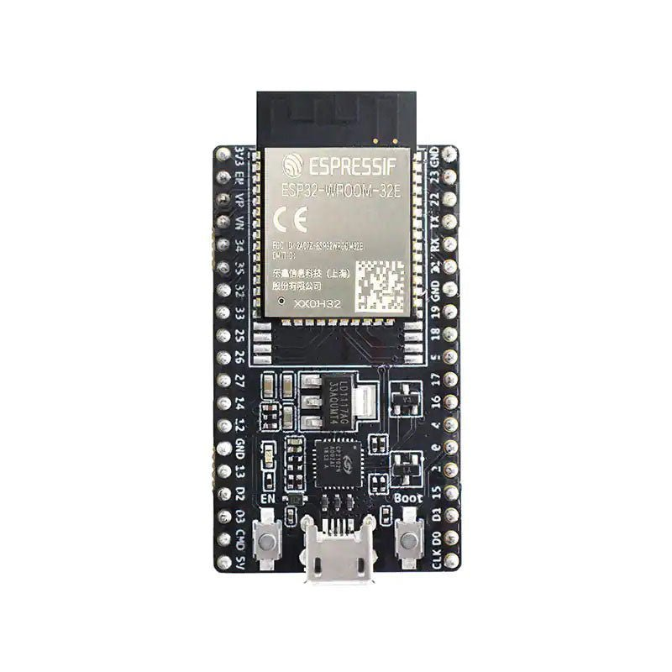
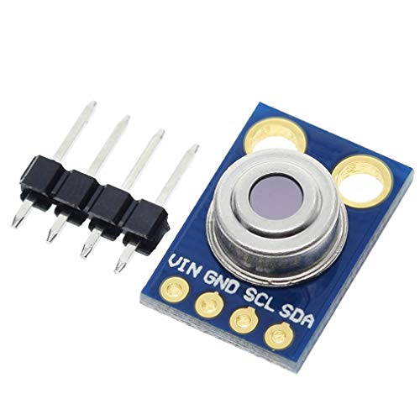
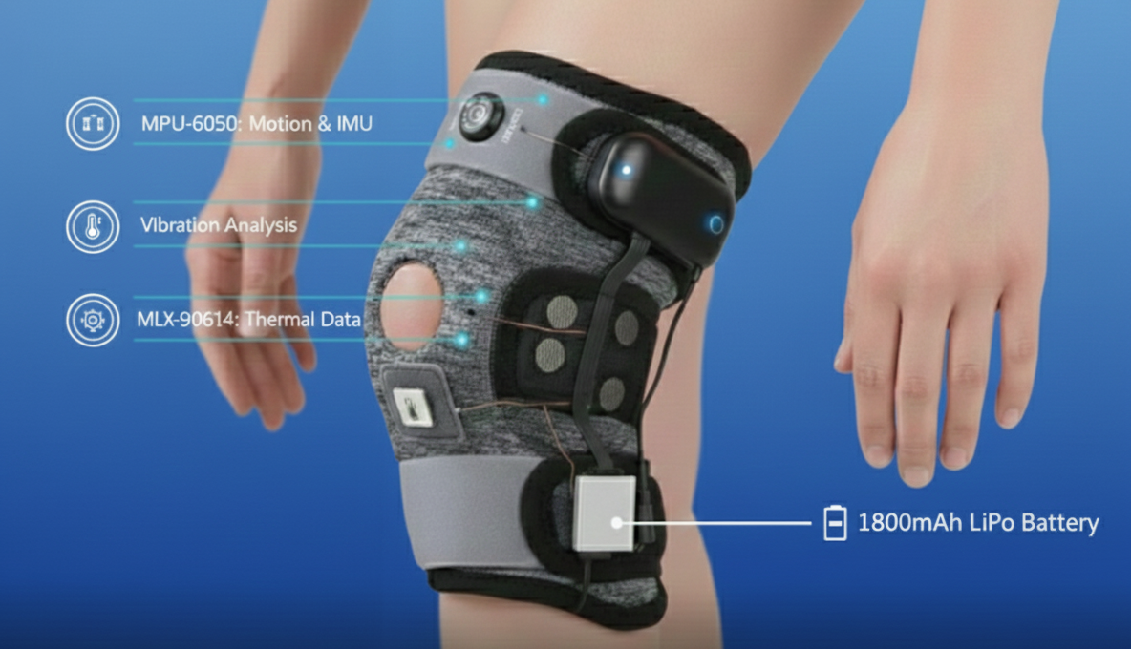
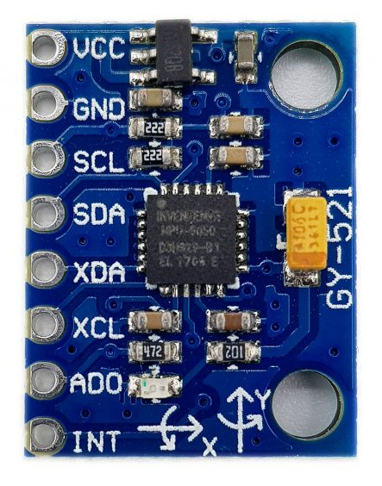
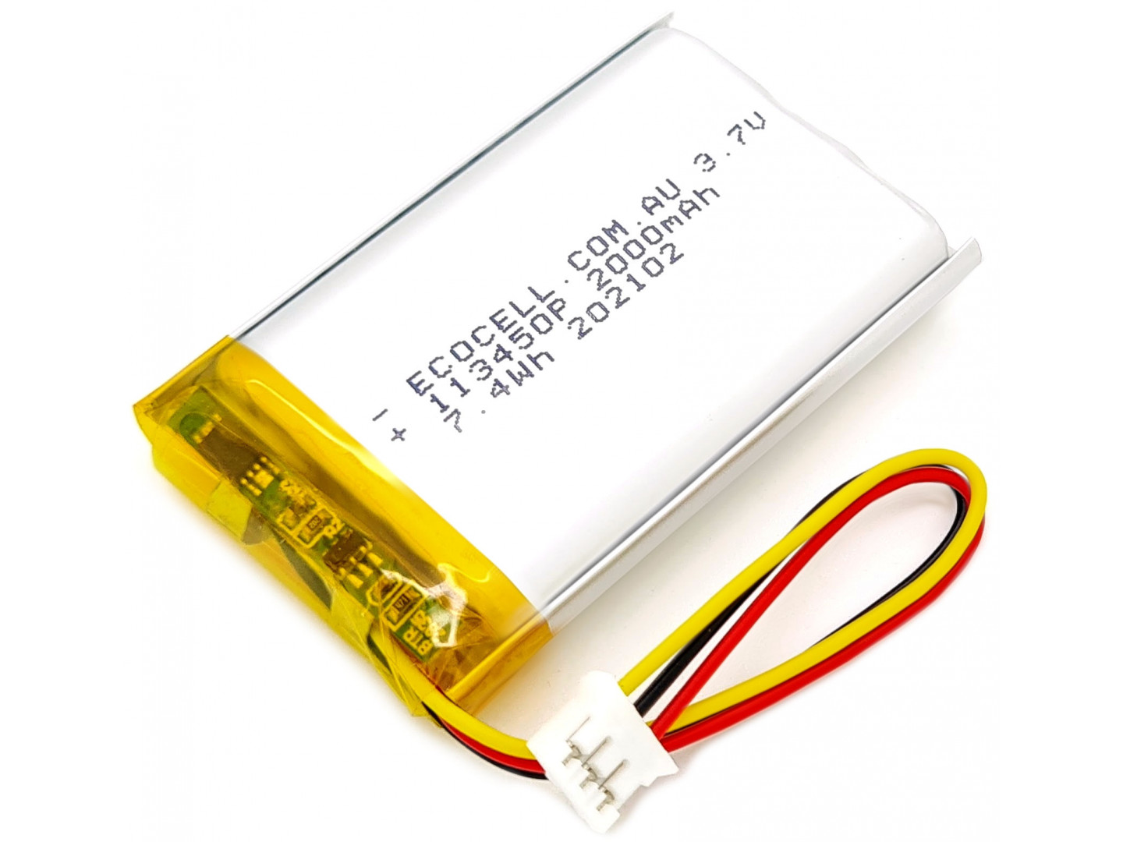
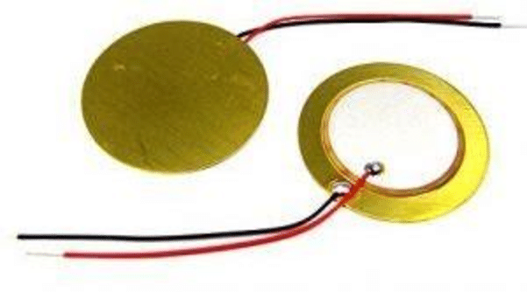
~ Smart IoT-Based Knee Health Monitoring System Using VAG Signals ~
Design Excellence / Contribution
Technical Contributions
Designed a multi-sensor wearable framework integrating VAG, motion, and pressure data
Applied EMD, EEMD, and VMD for signal denoising and feature extraction
Trained, evaluated, and compared machine learning models for KOA severity classification
Selected the best-performing model based on accuracies.
Infrared temperature sensor
ESP32
MPU6050
Lipo Battery
Piezo Disk
IT22188472 | Gamage D.M.G.P.K | 25-26J-112
27

Slide 25

~ Smart IoT-Based Knee Health Monitoring System Using VAG Signals ~
Design Excellence / Contribution
Models | Training Accuracy | Testing Accuracy | Validation Accuracy
Random Forest | 85.25 % | 56.20 % | 58.00 %
Logistic Regression | 62.14 % | 57.80 % | 59.20 %
LightGBM | 91.55 % | 53.00 % | 60.80 %
SVM | 88.17 % | 80.40 % | 77.20 %
CatBoost | 81.12 % | 56.60 % | 61.60 %
XGBoost | 97.62 % | 54.40 % | 60.00 %
Support Vector Machine (SVM) is the most balanced model, as it achieves the highest testing accuracy with consistent validation performance and minimal overfitting.
IT22188472 | Gamage D.M.G.P.K | 25-26J-112
28

Slide 26
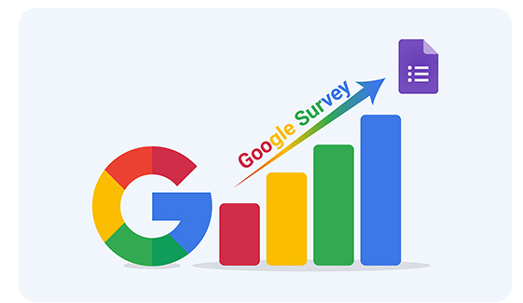

~ Smart IoT-Based Knee Health Monitoring System Using VAG Signals ~
User Feedback On Prototype
Feedback Collection Method
    Google Form survey
    Demo-based feedback from users
Future Work
Improve VAG-based ML model performance.
Deploy models using TinyML on ESP32
Real-time alerts for abnormal knee vibration patterns
IT22188472 | Gamage D.M.G.P.K | 25-26J-112
29

Slide 27
PROJECT OVERVIEW & COMMERCIALIZATION WORKFLOW
Ability of Commercialization
It can be used in clinics, hospitals, physiotherapy centers, and by home users.
Addresses the growing need for early detection and continuous monitoring of KOA.
Investment / Cost & Recovery
    Cloud servers
    App infrastructure
Subscription or pay-per-use mobile app monitoring
Target Market & Customer Profile
Primary market: Hospitals, orthopaedic clinics, and physiotherapy centers.
Secondary market: Elderly population, patients with knee issues, fitness/wellness centres.
31
30

Slide 28

Thanks
32

